Slide 1




ITE 4 Project | TheEnd
Development and Optimization of a BERT-Based Semantic Similarity System for Automated Summary Evaluation in Support of SDG 4
Presented by
Sarmiento, Charles Aaron
Baste, Laurence
Laniosa,Alexis

Slide 2
ITE 4 Project | TheEnd
Introduction
  This study focuses on developing an AI-powered system that evaluates how well a student’s summary matches the meaning of an academic text.
  It uses transformer-based models—specifically BERT and Sentence-BERT—to measure semantic similarity, going beyond simple grammar or keyword matching.
  The project responds to challenges in higher education where students often struggle to determine if their summaries accurately reflect the main ideas of the source.
  With the shift to digital and independent learning, students need instant, meaningful feedback, while instructors require tools that can support large classes efficiently.
Sarmiento, Charles Aaron.

Slide 3
ITE 4 Project | TheEnd
Domain and Problem Statement
Domain: Education, aligned with SDG 4: Quality Education
Problem:
  Students struggle to evaluate whether their summaries accurately reflect the original text.
  Lack of automated systems that measure semantic alignment, not just grammar or plagiarism.
  Instructors cannot manually evaluate all summaries, especially in large classes.
  Leads to learning inefficiency and misconceptions.
Baste, Laurence

Slide 4
ITE 4 Project | TheEnd
Significance of the Study
  Provides immediate semantic feedback to help students improve comprehension and metacognitive skills.
  Supports instructors with scalable assessment of student summaries.
  Enhances equitable access to quality feedback, supporting SDG 4 goals.
  Demonstrates practical application of transformer models in educational contexts.
Laniosa, Alexis

Slide 5
ITE 4 Project | TheEnd
Objectives
General Objective:
Develop and evaluate an AI-powered summary evaluation system using a fine-tuned BERT-based semantic similarity model.
Specific Objectives:
  Build an NLP pipeline to analyze academic content and student summaries.
  Fine-tune BERT/Sentence-BERT with multiple hyperparameters.
  Evaluate performance using Spearman/Pearson correlations.
  Integrate the model into a functional prototype for summary evaluation.
Sarmiento, Charles Aaron.

Slide 6
ITE 4 Project | TheEnd
Scope of Work
  Dataset loading and preprocessing.
  Model selection (MiniLM / Sentence-BERT).
  Hyperparameter optimization using Optuna.
  User interface creation for summary evaluation.
  Testing and performance evaluation using correlation scores.
Baste, Laurence

Slide 7
ITE 4 Project | TheEnd
Data Collection & Preprocessing
Dataset Sources:
  SciTLDR dataset from HuggingFace (source text + TL;DR summaries).
  External evaluation dataset (sentence pairs + similarity labels).
Steps:
  Normalize text data.
  Create positive and negative pairs.
  Build InputExample objects.
  Train/validation/test split preparation.
Laniosa, Alexis

Slide 8
ITE 4 Project | TheEnd
Data Collection & Preprocessing
Dataset Sources:
  SciTLDR dataset from HuggingFace (source text + TL;DR summaries).
  External evaluation dataset (sentence pairs + similarity labels).
Steps:
  Normalize text data.
  Create positive and negative pairs.
  Build InputExample objects.
  Train/validation/test split preparation.
Sarmiento, Charles Aaron.

Slide 9
ITE 4 Project | TheEnd
Model Architecture
Base Model: all-MiniLM-L6-v2 (Sentence-Transformers)
  Encodes both source text and student summary into embeddings.
  Uses MEAN pooling (best performing).
  Cosine similarity used to compute semantic alignment.
Laurence, Baste

Slide 10
ITE 4 Project | TheEnd
Training Procedure
  Training using CosineSimilarityLoss.
  Batch loading, warmup steps, and scheduled learning rate.
  Evaluation at intervals with Spearman & Pearson correlations.
  Training time recorded for efficiency comparison.
Laniosa,Alexis

Slide 11
ITE 4 Project | TheEnd
Hyperparameter Optimization
Using Optuna:
  Search space includes LR, batch size, dropout, warmup ratio, pooling strategy.
  Model built dynamically per trial.
  Best trial determined by highest Spearman correlation.
  Random Search outperformed Grid Search.
Sarmiento, Charles Aaron.

Slide 12
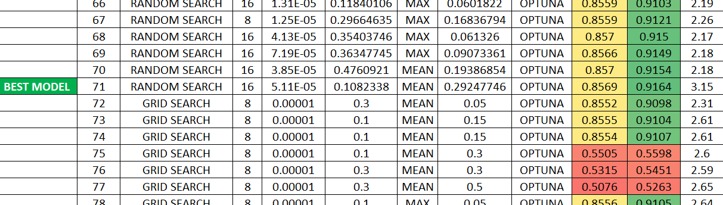
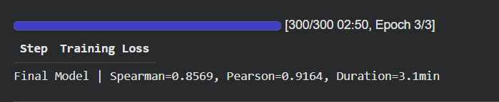
ITE 4 Project | TheEnd
Best Hyperparameters (Result)
Best Configuration:
  Batch size: 16
  Learning rate: 5.11×10⁻⁵
  Dropout: 0.108
  Pooling: MEAN
  Warmup ratio: 0.29
  Spearman: 0.8569
  Pearson: 0.9164
Laurence, Baste

Slide 13
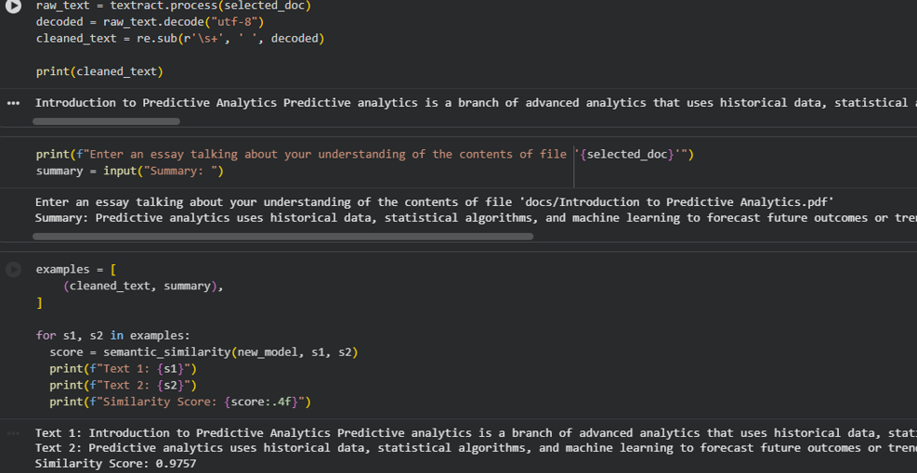
ITE 4 Project | TheEnd
Summary Evaluation Prototype
  Upload academic document → extract context.
  User writes a summary.
  System computes semantic similarity score (0–1).
  Feedback displayed instantly for student reflection.
Laniosa,Alexis

Slide 14
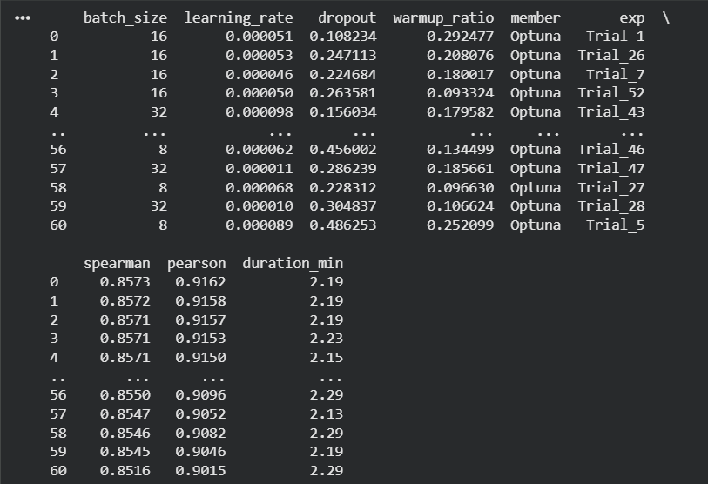
ITE 4 Project | TheEnd
Evaluation Metrics
  Spearman correlation: Ranking alignment.
  Pearson correlation: Linear similarity alignment.
  Together measure semantic accuracy relative to human judgment.
  Additional metric: Training time (minutes).
Sarmiento, Charles Aaron.

Slide 15
ITE 4 Project | TheEnd
Results & Discussion
  Random Search produced more stable and high-performing models.
  MEAN pooling consistently outperformed MAX pooling.
  Moderate learning rate and low dropout yield highest accuracy.
  Consistent correlations around 0.855–0.857.
  Prototype demonstrates practical educational use.
Laurence, Baste

Slide 16
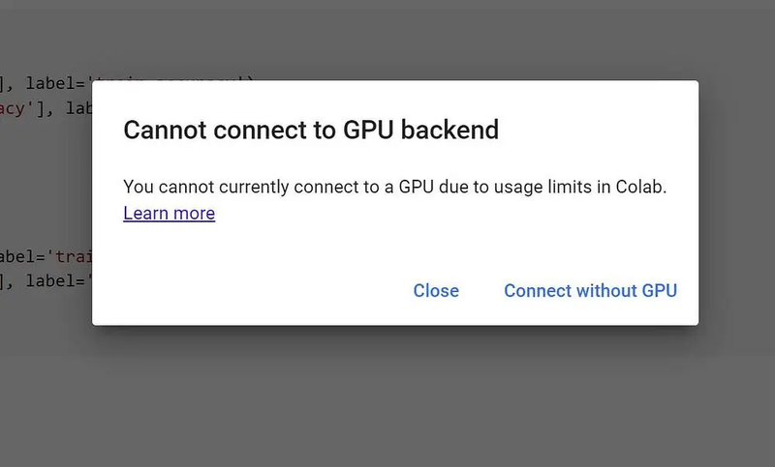
ITE 4 Project | TheEnd
Problems Encountered
  Difficulty finding appropriate datasets.
  Colab GPU limitations and interruptions.
  Long training times reduced iteration speed.
  Occasional memory resets affected reproducibility.
Laniosa, Alexis

Slide 17
ITE 4 Project | TheEnd
Conclusion
  Successfully developed a BERT-based semantic similarity model.
  Provided strong, stable performance for educational summary evaluation.
  Prototype demonstrated immediate, meaningful feedback aligned with SDG 4.
  Highlights promise of NLP tools for scalable, equitable learning support.
Sarmiento, Charles Aaron.

